Slide 1
106-1 DSnP Final Contest
電機二 B05901064 林承德
2018/3/16

Slide 2
Structure in class CirMgr
CirGate** _gates //_gates[n] = the gate whose id = n
vector<unsigned> _inputs //PI
vector<unsigned> _outputs //PO
vector<unsigned> _dfs
vector<unsigned> _notUsed //for cirsweep and cirp -fl
vector<FecPair* >* _fec
Notes:
_gates hash -> id
_notUsed

Slide 3
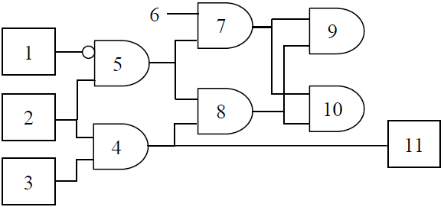
Cirsweep
X
X
X
X
X
_notUsed =
9
10
8
7
5
X
X
X
Sweeping : AIG(9) removed…
Sweeping : AIG(10) removed…
Sweeping : AIG(8) removed…
Sweeping : AIG(7) removed…
Sweeping : AIG(5) removed…
X
X
X
Best : O(1) Worst : O(n)

Slide 4
Cirfraig
Iterate every gates depending on DFS list precedence
If a gate’s Fecpair contain another gate which has higher precedence in DFS list, use SAT to prove or disprove the two gates.
If it is UNSAT, merge one of the gate to another.
If it is SAT, use the key to simulate and generate new Fecpair.
Drawbacks : simulate frequently

Slide 5
Cirfraig
strategy1
_dfs =
…
strategy2
1st
2nd
3rd
Strategy 2’s assumption :
The time SAT Engine costs is roughly depends on # of Pis.
A gate’s fanin group roughly equals the gates which have higher precedence in _dfs.
Merging a gate which has a larger fanin group is more efficient.
result :
strategy 2 gets stuck and almost stop when the circuit has around 15k AIGs while strategy 1 doesn’t.

Slide 6
Thanks for Listening

